Slide 1
Presentation of our Solutions
Elma Hodzic, Lukas Gesche, Ratna MCUT, Chan Zhu-Yuan, Amila Alikadic, Bastian Stehr

Slide 2
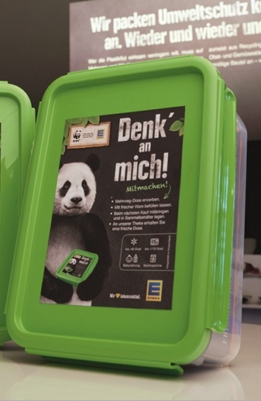
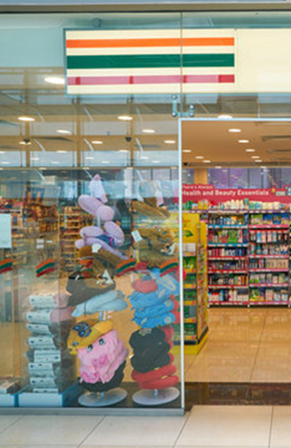
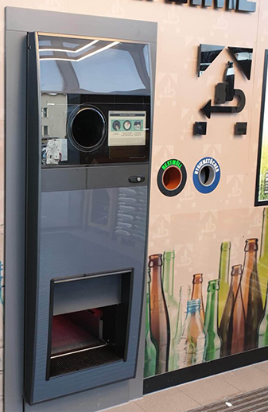
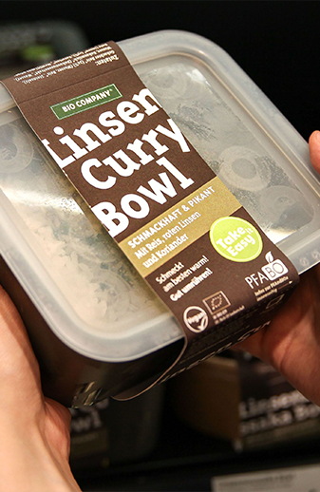
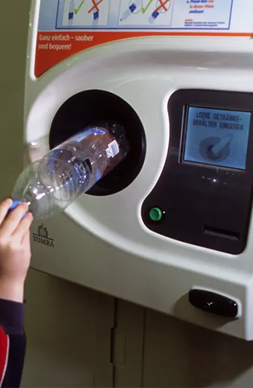
Our Solution Ideas
Recycling System for Plastics
Bring your own Bag System
Information Campaign
- Paying for a Deposit (similar to Germanys Bottle System) which is returned at the end - Offering Alternatives without Plastic as a solution/Cheaper Option
- Stands near Super Markets to raise Awareness
- Simple Solution that could make a large difference
- Bringing your Own Bag as Full Packaging - Products would be picked out of their own indiviuell Bags
2

Slide 3
Credits
https://i.guim.co.uk/img/media/03fab536d327cb2a5d288a82152cfb0ffbfeff33/133_206_4961_2978/master/4961.jpg?width=1020&quality=85&auto=format&fit=max&s=2dc3d2ac31113c408b9972a025e34027
https://allaboutberlin.com/images/_contentFullwidth2x/pfandautomat-edeka-bottle-return-machine.jpg
https://einzelhandelaktuell.de/wp-content/uploads/2020/02/180731_foto_edeka-mehrwegdose-1024x771.jpg
https://www.lebensmittelzeitung.net/news/media/22/Bio-Company-Pfandbox-212887.jpeg
https://t4.ftcdn.net/jpg/03/31/55/07/360_F_331550706_S7kgpqSCP8YI8sRAUuLYuqjl9uoekT12.jpg
https://www.datarush.co.uk/wp-content/uploads/2020/07/1_vThNvfV1i_uZbTP0FMCYyQ1.png
3

Slide 4
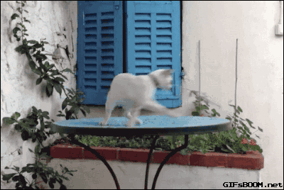
Thank you for your attention
4

